Slide 1

Welcome to Bible Class
欢迎参加圣经课程
The Messiah in the Old Testament
旧约中的弥赛亚

Slide 2

第二部分Part 2
THE MESSIAH IN THE PROPHETS
先知书中的弥赛亚
Lesson 5 = The Messiah in Isaiah Part 1
第五课=以赛亚书中的弥赛亚 第一部分
Lesson 6 = The Messiah in Isaiah Part 2
第六课=以赛亚书中的弥赛亚 第二部分
Lesson 7 = The Messiah In the Major Prophets
第七课=大先知书中的弥赛亚
Lesson 8 = The Messiah in the Minor Prophets
第八课=小先知书中的弥赛亚

Slide 3
1. Isaiah 2:1-5 = The Messiah as the refuge of the people
赛2:1-5=弥赛亚是人们的避难所
2. Isaiah 4:2 = The Messiah is the Branch of the Lord
赛4:2=弥赛亚是耶和华的苗
3. Isaiah 7:14 = The Messiah is born of a virgin
赛7:14=弥赛亚由童女所生
4. Isaiah 8:17-18 = The Messiah trusts in God
赛8:17-18=弥赛亚倚靠神
5. Isaiah 9:1-7 = The Messiah is the heir to the throne of David
赛9:1-7=弥赛亚是大卫王座的继承者
6. Isaiah 11:1-5 = The Messiah as the stump from Jesse
赛11:1-5=弥赛亚是耶西的本
7. Isaiah 24:21-26 = The triumph of the Messiah
赛24:21-26=弥赛亚得胜
8. Isaiah 28:16 = The Messiah as the precious cornerstone
赛28:16=弥赛亚是宝贵的房角石
9. Isaiah 30:19-26 = The Messiah as teacher
赛30:19-26=弥赛亚是教师

Slide 4
10. Isaiah 40:11 = The Messiah as the Good Shepherd
赛40:11=弥赛亚是好牧人
11. Isaiah 42:1-7 = The Messiah’s ministry
赛42:1-7=弥赛亚的服事
12. Isaiah 49:1-9 = The Messiah as the light for the Gentiles
赛49:1-9=弥赛亚是外邦人的光
13. Isaiah 50:4-11 = The Messiah is rejected
赛50:4-11=弥赛亚被弃绝
14. Isaiah 52:13-53:12 = The Messiah as suffering Servant
赛52:13-53:12=弥赛亚是受苦的仆人
15. Isaiah 55:3-5 = The Messiah’s unfailing gifts promised to David
赛55:3-5=弥赛亚是应许大卫的可靠的恩典
16. Isaiah 59:16 = The Messiah completes the mission alone
赛59:16=弥赛亚单独完成使命
17. Isaiah 61:1-2 = The Messiah proclaims good news
赛61:1-2=弥赛亚宣告福音
18. Isaiah 63:1-6 = The Messiah as conqueror
赛63:1-6=弥赛亚是征服者

Slide 5

THE VIRGIN’S SON
童女之子
Isaiah 7:11-14
赛7:11-14

Slide 6
Isaiah 7:11-14
“Ask the LORD your God for a sign, whether in the deepest depths or in the highest heights.” But Ahaz said, “I will not ask; I will not put the LORD to the test.” “Then Isaiah said, “Hear now, you house of David! Is it not enough to try the patience of men? Will you try the patience of my God also? Therefore the Lord himself will give you a sign: The virgin will be with child and will give birth to a son, and will call him Immanuel.”
赛7:11-14
“你向耶和华你的神求一个兆头。或求显在深处，或求显在高处。亚哈斯说，我不求，我不试探耶和华。以赛亚说，大卫家阿，你们当听。你们使人厌烦岂算小事，还要使我的神厌烦吗？因此，主自己要给你们一个兆头，必有童女怀孕生子，给他起名叫以马内利。（就是神与我们同在的意思）”

Slide 7
Isaiah 7:11-14
“Ask the LORD your God for a sign, whether in the deepest depths or in the highest heights.” But Ahaz said, “I will not ask; I will not put the LORD to the test.” “Then Isaiah said, “Hear now, you house of David! Is it not enough to try the patience of men? Will you try the patience of my God also? Therefore the Lord himself will give you a sign: The virgin will be with child and will give birth to a son, and will call him Immanuel.”
赛7:11-14
“你向耶和华你的神求一个兆头。或求显在深处，或求显在高处。亚哈斯说，我不求，我不试探耶和华。以赛亚说，大卫家阿，你们当听。你们使人厌烦岂算小事，还要使我的神厌烦吗？因此，主自己要给你们一个兆头，必有童女怀孕生子，给他起名叫以马内利。（就是神与我们同在的意思）”

Slide 8
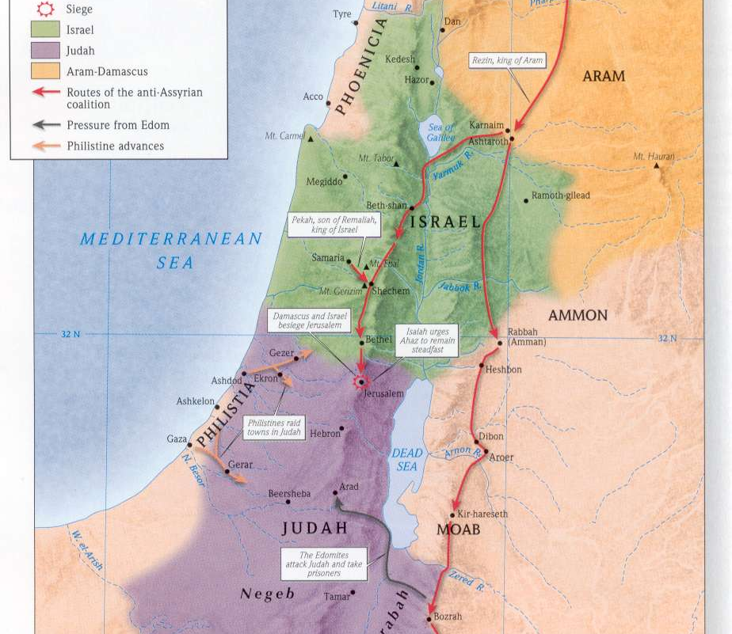
Rezin利汛
King of Aram
亚兰王
Pekah比加
King of Samaria
撒玛利亚王
“Let us invade Judah; let us tear it apart and divide it among ourselves, and make the son of Tabeel king over it.” (Isaiah 7:6)
“我们可以上去，攻击犹大，扰乱它，攻破它，在其中立他比勒的儿子为王。”（赛7:6）

Slide 9
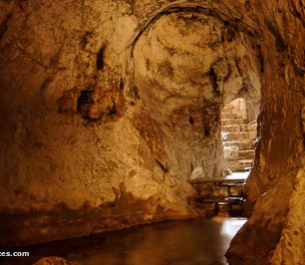
“If you do not stand firm in your faith, you will not stand at all.” (Isaiah 7:9)
“你们若是不信，定然不得立稳”（赛7:9）

Slide 10
ISAIAH 7:11-14
赛7:11-14
Psalm 146:3 - “Do not put your trust in princes, in mortal men, who cannot save.” 诗146:3-“你们不要倚靠君王，不要倚靠世人。他一点不能帮助。”
Psalm 50:15 - “Call upon me in the day of trouble; I will deliver you, and you will honor me.” 诗50:15-“并要在患难之日求告我，我必搭救你。你也要荣耀我。”

Slide 11
2 Kings 16:7-9
“Ahaz sent messengers to say to Tiglath-Pileser king of Assyria, “I am your servant and vassal. Come up and save me out of the hand of the king of Aram and of the king of Israel, who are attacking me.” And Ahaz took the silver and gold found in the temple of the LORD and in the treasuries of the royal palace and sent it as a gift to the king of Assyria. The king of Assyria complied by attacking Damascus and capturing it. He deported its inhabitants to Kir and put Rezin to death.”
王下16:7-9
亚哈斯差遣使者去见亚述王提革拉毗列色，说，我是你的仆人，你的儿子。现在亚兰王和以色列王攻击我，求你来救我脱离他们的手。亚哈斯将耶和华殿里和王宫府库里所有的金银都送给亚述王为礼物。亚述王应允了他，就上去攻打大马色，将城攻取，杀了利汛，把居民掳到吉珥。

Slide 12
Isaiah 7:11-14
“Ask the LORD your God for a sign, whether in the deepest depths or in the highest heights.” But Ahaz said, “I will not ask; I will not put the LORD to the test.” “Then Isaiah said, “Hear now, you house of David! Is it not enough to try the patience of men? Will you try the patience of my God also? Therefore the Lord himself will give you a sign: The virgin will be with child and will give birth to a son, and will call him Immanuel.”
赛7:11-14
“你向耶和华你的神求一个兆头。或求显在深处，或求显在高处。亚哈斯说，我不求，我不试探耶和华。以赛亚说，大卫家阿，你们当听。你们使人厌烦岂算小事，还要使我的神厌烦吗？因此，主自己要给你们一个兆头，必有童女怀孕生子，给他起名叫以马内利。（就是神与我们同在的意思）”
“If now I have found favor in your eyes, give me a sign that it is really you talking to me.” (Gideon in Judges 6:17)
“基甸说，我若在你眼前蒙恩，求你给我一个证据，使我知道与我说话的就是主。”（士6:17当中基甸如是说）

Slide 13
Isaiah 7:11-14
“Ask the LORD your God for a sign, whether in the deepest depths or in the highest heights.” But Ahaz said, “I will not ask; I will not put the LORD to the test.” “Then Isaiah said, “Hear now, you house of David! Is it not enough to try the patience of men? Will you try the patience of my God also? Therefore the Lord himself will give you a sign: The virgin will be with child and will give birth to a son, and will call him Immanuel.”
赛7:11-14
“你向耶和华你的神求一个兆头。或求显在深处，或求显在高处。亚哈斯说，我不求，我不试探耶和华。以赛亚说，大卫家阿，你们当听。你们使人厌烦岂算小事，还要使我的神厌烦吗？因此，主自己要给你们一个兆头，必有童女怀孕生子，给他起名叫以马内利。（就是神与我们同在的意思）”
“Do not test the LORD your God as you did at Massah.” (Deuteronomy 6:16)
“你们不可试探耶和华你们的神，象你们在玛撒那样试探他。”（申6:16）

Slide 14
Isaiah 7:11-14
“Ask the LORD your God for a sign, whether in the deepest depths or in the highest heights.” But Ahaz said, “I will not ask; I will not put the LORD to the test.” “Then Isaiah said, “Hear now, you house of David! Is it not enough to try the patience of men? Will you try the patience of my God also? Therefore the Lord himself will give you a sign: The virgin will be with child and will give birth to a son, and will call him Immanuel.”
赛7:11-14
“你向耶和华你的神求一个兆头。或求显在深处，或求显在高处。亚哈斯说，我不求，我不试探耶和华。以赛亚说，大卫家阿，你们当听。你们使人厌烦岂算小事，还要使我的神厌烦吗？因此，主自己要给你们一个兆头，必有童女怀孕生子，给他起名叫以马内利。（就是神与我们同在的意思）”
“almah” = “virgin”
“almah”=“童女”

Slide 15
ISAIAH 7:11-14
赛7:11-14
“See, I am standing beside this spring; if a maiden comes out to draw water …” (Genesis 24:43) “我如今站在井旁，对那一个出来打水的女子说……”（创24:43）
“And the girl went and got the baby’s mother.” (Exodus 2:8) “童女就去叫了孩子的母亲来。”（出2:8）
“the way of a man with a maiden.” (Proverbs 30:19) “男与女交合的道。”（箴30:19）
“In front are the singers, after them the musicians; with them are the maidens playing tambourines.” (Psalm 68:25) “歌唱的行在前，作乐的随在后，都在击鼓的童女中间。”（诗68:25）
“No wonder the maidens love you!” (Song of Solomon 1:3) “所以众童女都爱你。”（歌1:3）
“Sixty queens there may be, and eighty concubines, and virgins beyond number;” (Song of Solomon 6:8) “有六十王后八十妃嫔，并有无数的童女。”（歌6:8）

Slide 16
Matthew 1:18-25
“This is how the birth of Jesus Christ came about: His mother Mary was pledged to be married to Joseph, but before they came together, she was found to be with child through the Holy Spirit. Because Joseph her husband was a righteous man and did not want to expose her to public disgrace, he had in mind to divorce her quietly. But after he had considered this, an angel of the Lord appeared to him in a dream and said, “Joseph son of David, do not be afraid to take Mary home as your wife, because what is conceived in her is from the Holy Spirit.
太1:18-25
耶稣基督降生的事，记在下面。他母亲马利亚已经许配了约瑟，还没有迎娶，马利亚就从圣灵怀了孕。她丈夫约瑟是个义人，不愿意明明地羞辱她，想要暗暗地把她休了。正思念这事的时候，有主的使者向他梦中显现，说大卫的子孙约瑟，不要怕，只管娶过你的妻子马利亚来。因她所怀的孕，是从圣灵来的。

Slide 17
She will give birth to a son, and you are to give him the name Jesus, because he will save his people from their sins.” All this took place to fulfill what the Lord had said through the prophet: “The virgin will be with child and will give birth to a son, and they will call him Immanuel”—which means, “God with us.” When Joseph woke up, he did what the angel of the Lord had commanded him and took Mary home as his wife. But he had no union with her until she gave birth to a son. And he gave him the name Jesus.” (Matthew 1:18-25)
她将要生一个儿子。你要给他起名叫耶稣。因他要将自己的百姓从罪恶里救出来。这一切的事成就，是要应验主借先知所说的话，说，必有童女，怀孕生子，人要称他的名为以马内利。（以马内利翻出来，就是神与我们同在。）约瑟醒了，起来，就遵着主使者的吩咐，把妻子娶过来。只是没有和她同房，等她生了儿子，就给他起名叫耶稣。（太1:18-25）

Slide 18
ISAIAH 7:11-14
赛7:11-14
9) What do we now know about the Messiah?
现在我们知道关于弥赛亚的什么信息？
We learn that the Messiah will be born of a virgin.我们知道弥赛亚是由童女所生
We learn that he will be called “Immanuel” which means “God is with us.” 我们知道他会被称为“以马内利”，意思是“神与我们同在”。
We also learn that the Messiah will be a sign that God has not forsaken us and that he will deliver us from our enemies. 我们也知道弥赛亚是神没有离弃我们的兆头，他会把我们从仇敌手中拯救出来。

Slide 19
ISAIAH 7:11-14
赛7:11-14
10) Why is the virgin birth as essential part of the Christian faith?
童女生子为什么是基督教信至关重要的一部分？

Slide 20
LIGHT FOR THE GENTILES
外邦人的光
Isaiah 9:1-7
赛9:1-7

Slide 21
Isaiah 9:1-4
“Nevertheless, there will be no more gloom for those who were in distress. In the past he humbled the land of Zebulun and the land of Naphtali, but in the future he will honor Galilee of the Gentiles, by the way of the sea, along the Jordan— ² The people walking in darkness have seen a great light; on those living in the land of the shadow of death a light has dawned. ³ You have enlarged the nation and increased their joy; they rejoice before you as people rejoice at the harvest, as men rejoice when dividing the plunder. ⁴ For as in the day of Midian’s defeat, you have shattered the yoke that burdens them, the bar across their shoulders, the rod of their oppressor.
赛9:1-4
“1 但那受过痛苦的，必不再见幽暗。从前神使西布伦地，和拿弗他利地被藐视。末后却使这沿海的路，约旦河外，外邦人的加利利地，得着荣耀。2 在黑暗中行走的百姓，看见了大光。住在死荫之地的人，有光照耀他们。3 你使这国民繁多，加增他们的喜乐。他们在你面前欢喜，好像收割的欢喜，像人分掳物那样的快乐。4 因为他们所负的重轭，和肩头上的杖，并欺压他们人的棍，你都已经折断，好像在米甸的日子一样。

Slide 22
Isaiah 9:5-7
⁵ Every warrior’s boot used in battle and every garment rolled in blood will be destined for burning, will be fuel for the fire. ⁶ For to us a child is born, to us a son is given, and the government will be on his shoulders. And he will be called Wonderful Counselor, Mighty God, Everlasting Father, Prince of Peace. ⁷ Of the increase of his government and peace there will be no end. He will reign on David’s throne and over his kingdom, establishing and upholding it with justice and righteousness from that time on and forever. The zeal of the LORD Almighty will accomplish this.”
赛9:5-7
5 战士在乱杀之间所穿戴的盔甲，并那滚在血中的衣服，都必作为可烧的，当作火柴。6 因有一婴孩为我们而生，有一子赐给我们。政权必担在他的肩头上。他名称为奇妙，策士，全能的神，永在的父，和平的君。7 他的政权与平安必加增无穷。他必在大卫的宝座上，治理他的国，以公平公义使国坚定稳固，从今直到永远。万军之耶和华的热心，必成就这事。”

Slide 23
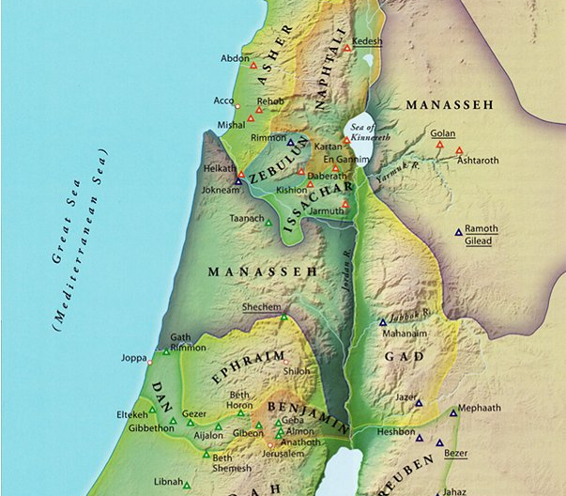
拿弗他利
西布伦

Slide 24
Isaiah 9:1-6
“Nevertheless, there will be no more gloom for those who were in distress. In the past he humbled the land of Zebulun and the land of Naphtali, but in the future he will honor Galilee of the Gentiles, by the way of the sea, along the Jordan— ² The people walking in darkness have seen a great light; on those living in the land of the shadow of death a light has dawned. ³ You have enlarged the nation and increased their joy; they rejoice before you as people rejoice at the harvest, as men rejoice when dividing the plunder. ⁴ For as in the day of Midian’s defeat, you have shattered the yoke that burdens them, the bar across their shoulders, the rod of their oppressor. ⁵ Every warrior’s boot used in battle and every garment rolled in blood will be destined for burning, will be fuel for the fire. ⁶ For to us a child is born, to us a son is given, and the government will be on his shoulders.
赛9:1-6
“1 但那受过痛苦的，必不再见幽暗。从前神使西布伦地，和拿弗他利地被藐视。末后却使这沿海的路，约旦河外，外邦人的加利利地，得着荣耀。2 在黑暗中行走的百姓，看见了大光。住在死荫之地的人，有光照耀他们。3 你使这国民繁多，加增他们的喜乐。他们在你面前欢喜，好像收割的欢喜，像人分掳物那样的快乐。4 因为他们所负的重轭，和肩头上的杖，并欺压他们人的棍，你都已经折断，好像在米甸的日子一样。5 战士在乱杀之间所穿戴的盔甲，并那滚在血中的衣服，都必作为可烧的，当作火柴。6 因有一婴孩为我们而生，有一子赐给我们。政权必担在他的肩头上。他名称为奇妙，策士，全能的神，永在的父，和平的君。

Slide 25
Isaiah 9:5-7
⁵ Every warrior’s boot used in battle and every garment rolled in blood will be destined for burning, will be fuel for the fire. ⁶ For to us a child is born, to us a son is given, and the government will be on his shoulders. And he will be called Wonderful Counselor, Mighty God, Everlasting Father, Prince of Peace. ⁷ Of the increase of his government and peace there will be no end. He will reign on David’s throne and over his kingdom, establishing and upholding it with justice and righteousness from that time on and forever. The zeal of the LORD Almighty will accomplish this.”
赛9:5-7
5 战士在乱杀之间所穿戴的盔甲，并那滚在血中的衣服，都必作为可烧的，当作火柴。6 因有一婴孩为我们而生，有一子赐给我们。政权必担在他的肩头上。他名称为奇妙，策士，全能的神，永在的父，和平的君。7 他的政权与平安必加增无穷。他必在大卫的宝座上，治理他的国，以公平公义使国坚定稳固，从今直到永远。万军之耶和华的热心，必成就这事。”

Slide 26
Matthew 4:12-17, 23
When Jesus heard that John had been put in prison, he returned to Galilee. ¹³ Leaving Nazareth, he went and lived in Capernaum, which was by the lake in the area of Zebulun and Naphtali— ¹⁴ to fulfill what was said through the prophet Isaiah: ¹⁵ “Land of Zebulun and land of Naphtali, the way to the sea, along the Jordan, Galilee of the Gentiles— ¹⁶ the people living in darkness have seen a great light; on those living in the land of the shadow of death a light has dawned.” ¹⁷ From that time on Jesus began to preach, “Repent, for the kingdom of heaven is near.” ²³ Jesus went throughout Galilee, teaching in their synagogues, preaching the good news of the kingdom, and healing every disease and sickness among the people.”
太4:12-17,23
12 耶稣听见约翰下了监，就退到加利利去。13 后又离开拿撒勒，往迦百农去，就住在那里。那地方靠海，在西布伦和拿弗他利的边界上。14 这是要应验先知以赛亚的话，15 说，西布伦地，拿弗他利地，就是沿海的路，约但河外，外邦人的加利利地。16 那坐在黑暗里的百姓，看见了大光，坐在死荫之地的人，有光发现照着他们。17 从那时候耶稣就传起道来，说，天国近了，你们应当悔改。23 耶稣走遍加利利，在各会堂里教训人，传天国的福音，医治百姓各样的病症。

Slide 27
ISAIAH 7:11-14
赛7:11-14
15) What do we now know about the Messiah?
我们现在知道关于弥赛亚的什么信息？
We learn that the Messiah will minister in the land of Galilee.我们知道弥赛亚在加利利地事奉。
We learn that he will be a light for the Gentiles. 我们知道他是外邦人的光。
We learn that he will be an everlasting king.我们知道他是永远的君王。

Slide 28
THE ROOT OF JESSE
耶西的本
Isaiah 11:1-10
赛11:1-10

Slide 29
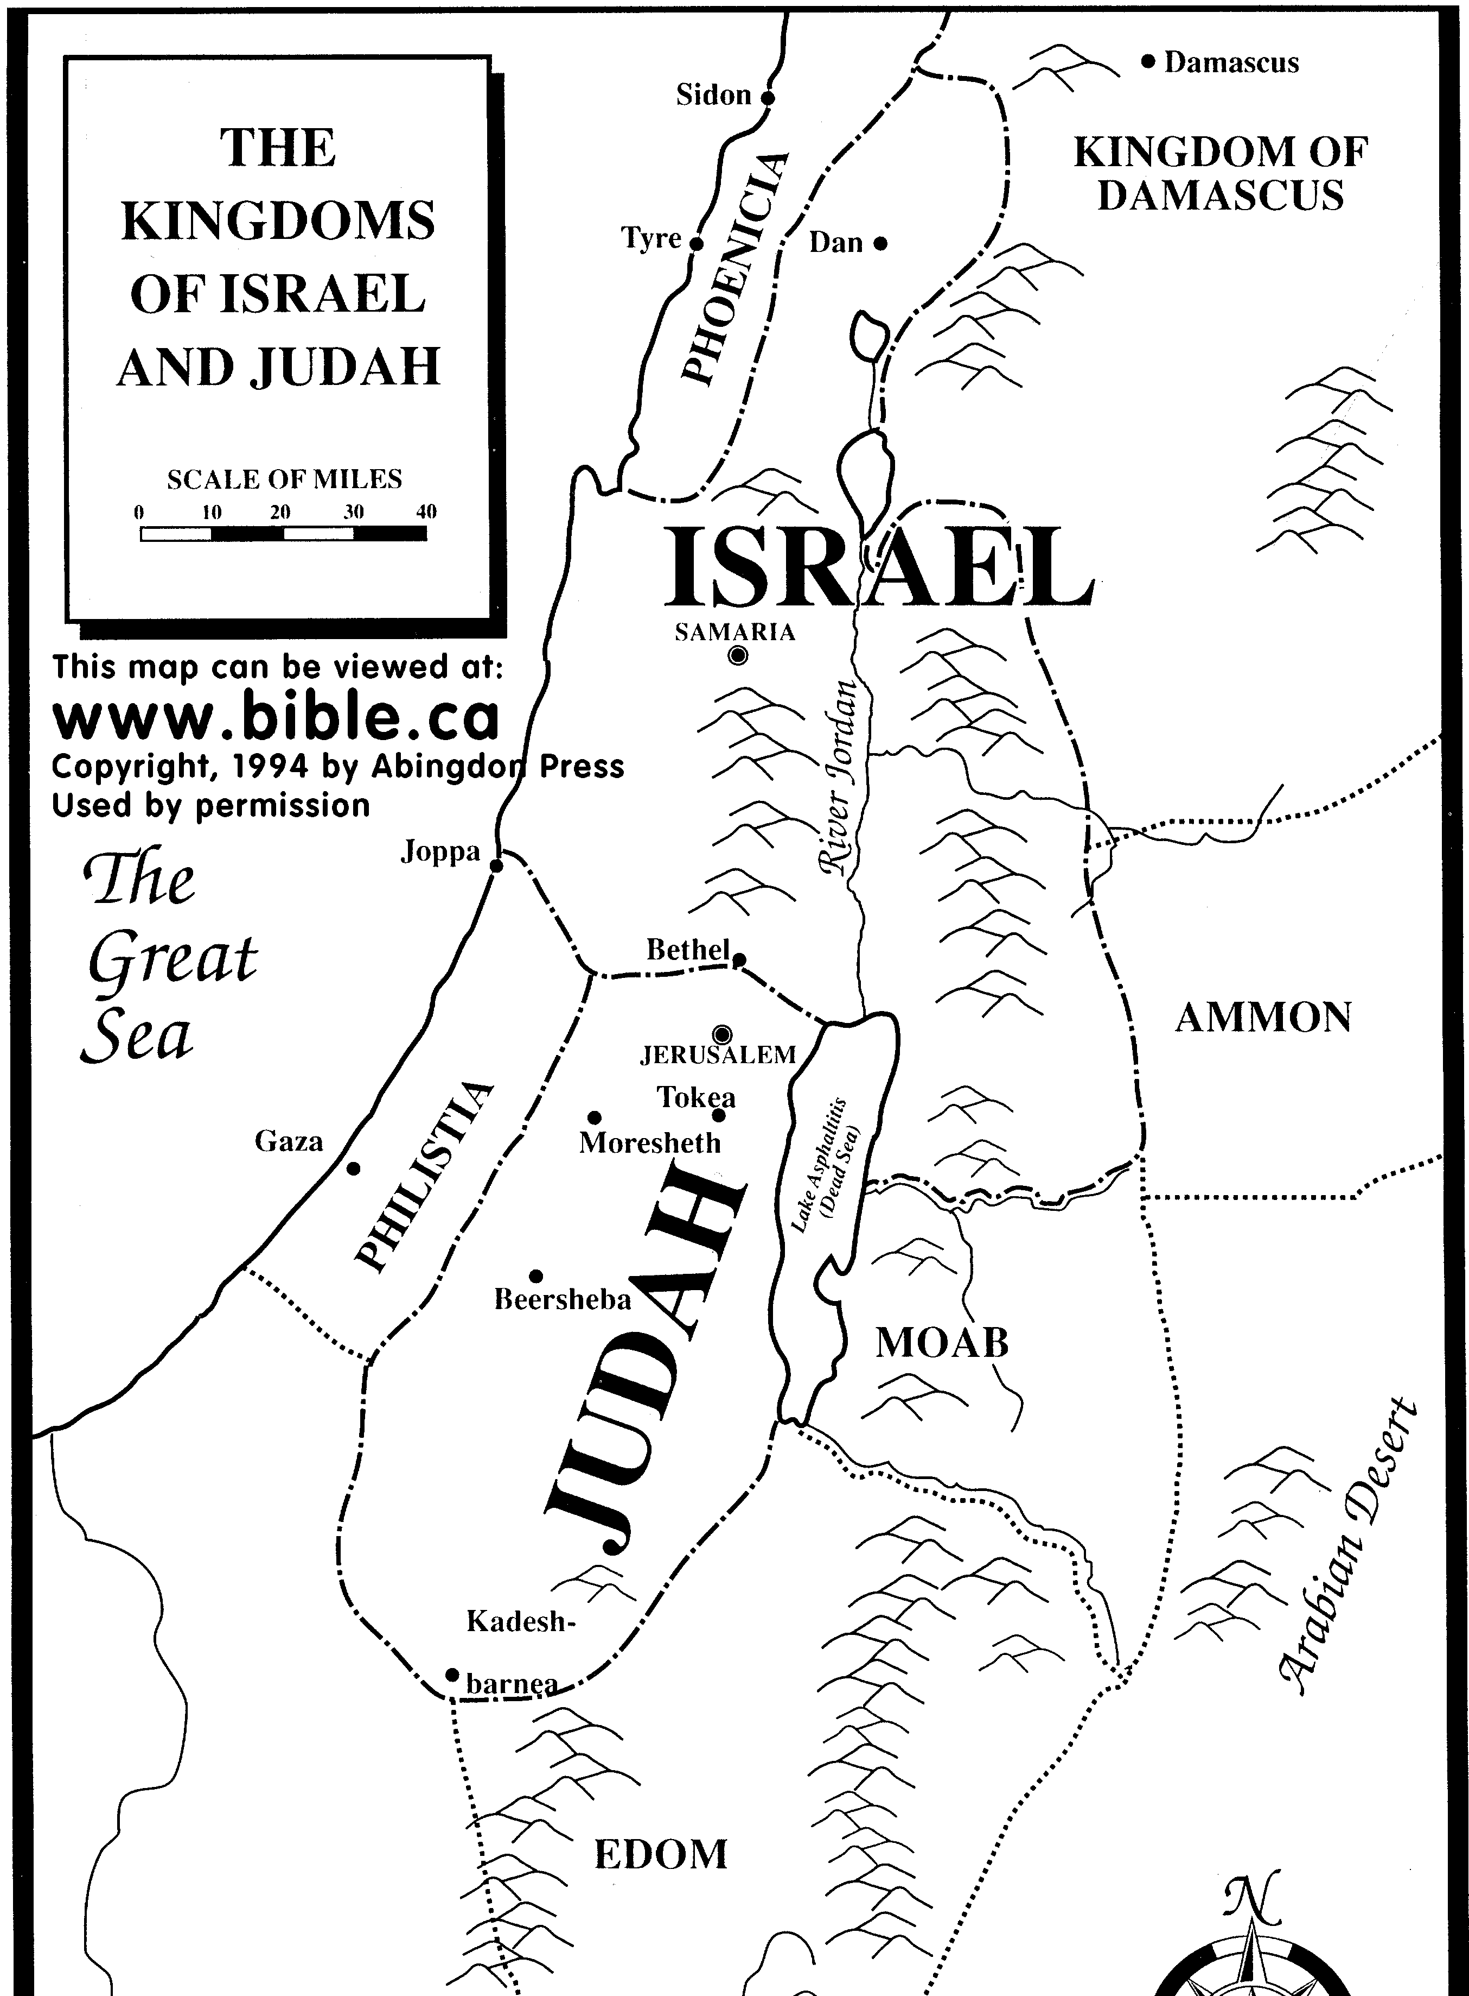
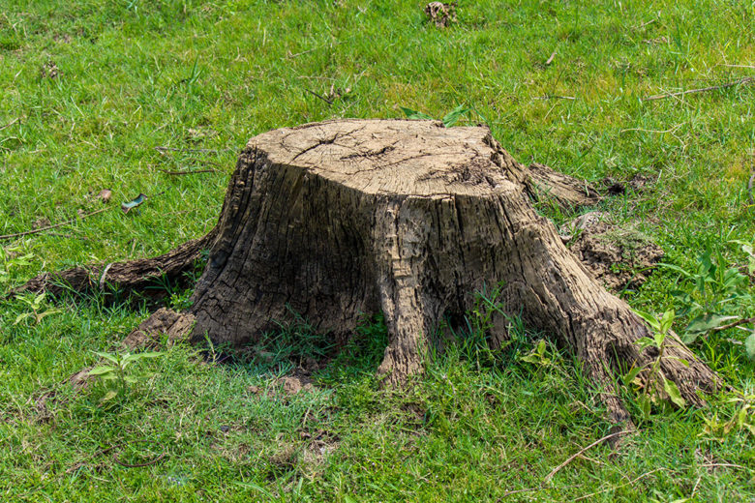
ISAIAH 11:1-10
Babylonians
巴比伦人

Slide 30
Isaiah 11:1-10
“A shoot will come up from the stump of Jesse; from his roots a Branch will bear fruit. ² The Spirit of the LORD will rest on him— the Spirit of wisdom and of understanding, the Spirit of counsel and of power, the Spirit of knowledge and of the fear of the LORD— ³ and he will delight in the fear of the LORD. He will not judge by what he sees with his eyes or decide by what he hears with his ears; ⁴ but with righteousness he will judge the needy, with justice he will give decisions for the poor of the earth. He will strike the earth with the rod of his mouth; with the breath of his lips he will slay the wicked. ⁵ Righteousness will be his belt and faithfulness the sash around his waist. ⁶ The wolf will live with the lamb, the leopard will lie down with the goat, the calf and the lion and the yearling together; and a little child will lead them. ⁷ The cow will feed with the bear, their young will lie down together, and the lion will eat straw like the ox. ⁸ The infant will play near the hole of the cobra, and the young child put his hand into the viper’s nest. ⁹ They will neither harm nor destroy on all my holy mountain, for the earth will be full of the knowledge of the LORD as the waters cover the sea. ¹⁰ In that day the Root of Jesse will stand as a banner for the peoples; the nations will rally to him, and his place of rest will be glorious.
赛11:1-10
“1从耶西的本必发一条，从他根生的枝子必结果实。2耶和华的灵必住在他身上，就是使他有智慧和聪明的灵，谋略和能力的灵，知识和敬畏耶和华的灵。3他必以敬畏耶和华为乐。行审判不凭眼见，断是非也不凭耳闻。4却要以公义审判贫穷人，以正直判断世上的谦卑人。以口中的杖击打世界。以嘴里的气杀戮恶人。5公义必当他的腰带，信实必当他胁下的带子。6豺狼必与绵羊羔同居，豹子与山羊羔同卧。少壮狮子，与牛犊，并肥畜同群。小孩子要牵引他们。7牛必与熊同食。牛犊必与小熊同卧。狮子必吃草与牛一样。8吃奶的孩子必玩耍在虺蛇的洞口，断奶的婴儿必按手在毒蛇的穴上。9在我圣山的遍处，这一切都不伤人，不害物。因为认识耶和华的知识要充满遍地，好像水充满洋海一般。10到那日，耶西的根立作万民的大旗。外邦人必寻求他。他安息之所大有荣耀。”

Slide 31
Isaiah 11:1-10
“A shoot will come up from the stump of Jesse; from his roots a Branch will bear fruit. ² The Spirit of the LORD will rest on him— the Spirit of wisdom and of understanding, the Spirit of counsel and of power, the Spirit of knowledge and of the fear of the LORD— ³ and he will delight in the fear of the LORD. He will not judge by what he sees with his eyes or decide by what he hears with his ears; ⁴ but with righteousness he will judge the needy, with justice he will give decisions for the poor of the earth. He will strike the earth with the rod of his mouth; with the breath of his lips he will slay the wicked. ⁵ Righteousness will be his belt and faithfulness the sash around his waist. ⁶ The wolf will live with the lamb, the leopard will lie down with the goat, the calf and the lion and the yearling together; and a little child will lead them. ⁷ The cow will feed with the bear, their young will lie down together, and the lion will eat straw like the ox. ⁸ The infant will play near the hole of the cobra, and the young child put his hand into the viper’s nest. ⁹ They will neither harm nor destroy on all my holy mountain, for the earth will be full of the knowledge of the LORD as the waters cover the sea. ¹⁰ In that day the Root of Jesse will stand as a banner for the peoples; the nations will rally to him, and his place of rest will be glorious.
赛11:1-10
“1从耶西的本必发一条，从他根生的枝子必结果实。2耶和华的灵必住在他身上，就是使他有智慧和聪明的灵，谋略和能力的灵，知识和敬畏耶和华的灵。3他必以敬畏耶和华为乐。行审判不凭眼见，断是非也不凭耳闻。4却要以公义审判贫穷人，以正直判断世上的谦卑人。以口中的杖击打世界。以嘴里的气杀戮恶人。5公义必当他的腰带，信实必当他胁下的带子。6豺狼必与绵羊羔同居，豹子与山羊羔同卧。少壮狮子，与牛犊，并肥畜同群。小孩子要牵引他们。7牛必与熊同食。牛犊必与小熊同卧。狮子必吃草与牛一样。8吃奶的孩子必玩耍在虺蛇的洞口，断奶的婴儿必按手在毒蛇的穴上。9在我圣山的遍处，这一切都不伤人，不害物。因为认识耶和华的知识要充满遍地，好像水充满洋海一般。10到那日，耶西的根立作万民的大旗。外邦人必寻求他。他安息之所大有荣耀。”

Slide 32
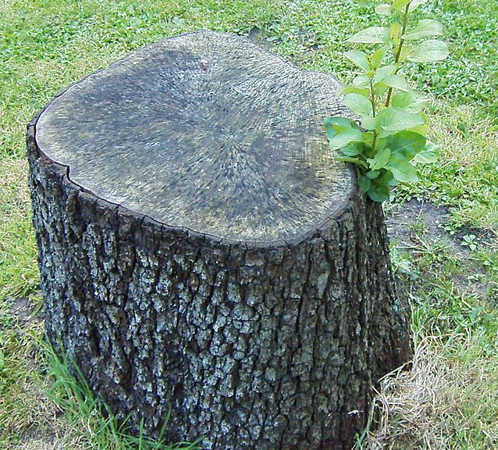
Isaiah 11:1-10
“A shoot will come up from the stump of Jesse; from his roots a Branch will bear fruit. ² The Spirit of the LORD will rest on him— the Spirit of wisdom and of understanding, the Spirit of counsel and of power, the Spirit of knowledge and of the fear of the LORD— ³ and he will delight in the fear of the LORD. He will not judge by what he sees with his eyes or decide by what he hears with his ears; ⁴ but with righteousness he will judge the needy, with justice he will give decisions for the poor of the earth. He will strike the earth with the rod of his mouth; with the breath of his lips he will slay the wicked. ⁵ Righteousness will be his belt and faithfulness the sash around his waist. ⁶ The wolf will live with the lamb, the leopard will lie down with the goat, the calf and the lion and the yearling together; and a little child will lead them. ⁷ The cow will feed with the bear, their young will lie down together, and the lion will eat straw like the ox. ⁸ The infant will play near the hole of the cobra, and the young child put his hand into the viper’s nest. ⁹ They will neither harm nor destroy on all my holy mountain, for the earth will be full of the knowledge of the LORD as the waters cover the sea. ¹⁰ In that day the Root of Jesse will stand as a banner for the peoples; the nations will rally to him, and his place of rest will be glorious.
赛11:1-10
“1从耶西的本必发一条，从他根生的枝子必结果实。2耶和华的灵必住在他身上，就是使他有智慧和聪明的灵，谋略和能力的灵，知识和敬畏耶和华的灵。3他必以敬畏耶和华为乐。行审判不凭眼见，断是非也不凭耳闻。4却要以公义审判贫穷人，以正直判断世上的谦卑人。以口中的杖击打世界。以嘴里的气杀戮恶人。5公义必当他的腰带，信实必当他胁下的带子。6豺狼必与绵羊羔同居，豹子与山羊羔同卧。少壮狮子，与牛犊，并肥畜同群。小孩子要牵引他们。7牛必与熊同食。牛犊必与小熊同卧。狮子必吃草与牛一样。8吃奶的孩子必玩耍在虺蛇的洞口，断奶的婴儿必按手在毒蛇的穴上。9在我圣山的遍处，这一切都不伤人，不害物。因为认识耶和华的知识要充满遍地，好像水充满洋海一般。10到那日，耶西的根立作万民的大旗。外邦人必寻求他。他安息之所大有荣耀。”
Romans 15:12 -- Isaiah says, “The Root of Jesse will spring up, one who will arise to rule over the nations; the Gentiles will hope in him.”
罗15:12--又有以赛亚说，将来有耶西的根，就是那兴起来要治理外邦的。外邦人要仰望他。
Revelation 22:16 -- “I, Jesus, am the Root and the Offspring of David.”
启22:16—“我是大卫的根，又是他的后裔。”

Slide 33
Isaiah 11:1-10
“A shoot will come up from the stump of Jesse; from his roots a Branch will bear fruit. ² The Spirit of the LORD will rest on him— the Spirit of wisdom and of understanding, the Spirit of counsel and of power, the Spirit of knowledge and of the fear of the LORD— ³ and he will delight in the fear of the LORD. He will not judge by what he sees with his eyes or decide by what he hears with his ears; ⁴ but with righteousness he will judge the needy, with justice he will give decisions for the poor of the earth. He will strike the earth with the rod of his mouth; with the breath of his lips he will slay the wicked. ⁵ Righteousness will be his belt and faithfulness the sash around his waist. ⁶ The wolf will live with the lamb, the leopard will lie down with the goat, the calf and the lion and the yearling together; and a little child will lead them. ⁷ The cow will feed with the bear, their young will lie down together, and the lion will eat straw like the ox. ⁸ The infant will play near the hole of the cobra, and the young child put his hand into the viper’s nest. ⁹ They will neither harm nor destroy on all my holy mountain, for the earth will be full of the knowledge of the LORD as the waters cover the sea. ¹⁰ In that day the Root of Jesse will stand as a banner for the peoples; the nations will rally to him, and his place of rest will be glorious.
赛11:1-10
“1从耶西的本必发一条，从他根生的枝子必结果实。2耶和华的灵必住在他身上，就是使他有智慧和聪明的灵，谋略和能力的灵，知识和敬畏耶和华的灵。3他必以敬畏耶和华为乐。行审判不凭眼见，断是非也不凭耳闻。4却要以公义审判贫穷人，以正直判断世上的谦卑人。以口中的杖击打世界。以嘴里的气杀戮恶人。5公义必当他的腰带，信实必当他胁下的带子。6豺狼必与绵羊羔同居，豹子与山羊羔同卧。少壮狮子，与牛犊，并肥畜同群。小孩子要牵引他们。7牛必与熊同食。牛犊必与小熊同卧。狮子必吃草与牛一样。8吃奶的孩子必玩耍在虺蛇的洞口，断奶的婴儿必按手在毒蛇的穴上。9在我圣山的遍处，这一切都不伤人，不害物。因为认识耶和华的知识要充满遍地，好像水充满洋海一般。10到那日，耶西的根立作万民的大旗。外邦人必寻求他。他安息之所大有荣耀。”
“When all the people were being baptized, Jesus was baptized too. And as he was praying, heaven was opened and the Holy Spirit descended on him in bodily form like a dove.” (Luke 3:21–22)
“He went to Nazareth, where he had been brought up, and on the Sabbath day he went into the synagogue, as was his custom. And he stood up to read. The scroll of the prophet Isaiah was handed to him. Unrolling it, he found the place where it is written: “The Spirit of the Lord is on me, because he has anointed me to preach good news to the poor. He has sent me to proclaim freedom for the prisoners and recovery of sight for the blind, to release the oppressed,” (Luke 4:16–18)
“众百姓都受了洗，耶稣也受了洗，正祷告的时候，天就开了，圣灵降临在他身上，形状仿佛鸽子。又有声音从天上来，说，你是我的爱子，我喜悦你。”（路3:21-22）
“耶稣来到拿撒勒，就是他长大的地方。在安息日，照他平常的规矩，进了会堂，站起来要念圣经。
有人把先知以赛亚的书交给他，他就打开，找到一处写着说，主的灵在我身上，因为他用膏膏我，叫我传福音给贫穷的人。差遣我报告被掳的得释放，瞎眼的得看见，叫那受压制的得自由”（路4:16-18）

Slide 34
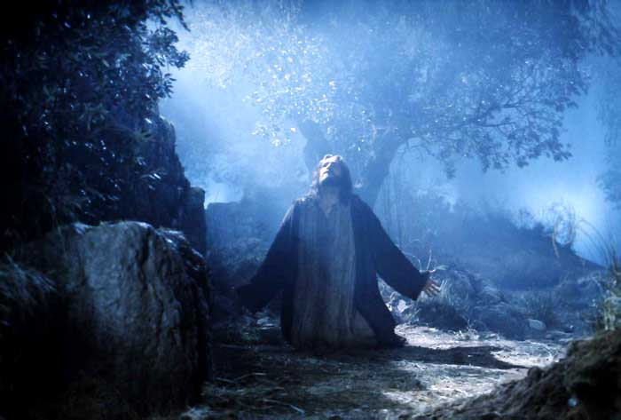
Isaiah 11:1-10
“A shoot will come up from the stump of Jesse; from his roots a Branch will bear fruit. ² The Spirit of the LORD will rest on him— the Spirit of wisdom and of understanding, the Spirit of counsel and of power, the Spirit of knowledge and of the fear of the LORD— ³ and he will delight in the fear of the LORD. He will not judge by what he sees with his eyes or decide by what he hears with his ears; ⁴ but with righteousness he will judge the needy, with justice he will give decisions for the poor of the earth. He will strike the earth with the rod of his mouth; with the breath of his lips he will slay the wicked. ⁵ Righteousness will be his belt and faithfulness the sash around his waist. ⁶ The wolf will live with the lamb, the leopard will lie down with the goat, the calf and the lion and the yearling together; and a little child will lead them. ⁷ The cow will feed with the bear, their young will lie down together, and the lion will eat straw like the ox. ⁸ The infant will play near the hole of the cobra, and the young child put his hand into the viper’s nest. ⁹ They will neither harm nor destroy on all my holy mountain, for the earth will be full of the knowledge of the LORD as the waters cover the sea. ¹⁰ In that day the Root of Jesse will stand as a banner for the peoples; the nations will rally to him, and his place of rest will be glorious.
赛11:1-10
“1从耶西的本必发一条，从他根生的枝子必结果实。2耶和华的灵必住在他身上，就是使他有智慧和聪明的灵，谋略和能力的灵，知识和敬畏耶和华的灵。3他必以敬畏耶和华为乐。行审判不凭眼见，断是非也不凭耳闻。4却要以公义审判贫穷人，以正直判断世上的谦卑人。以口中的杖击打世界。以嘴里的气杀戮恶人。5公义必当他的腰带，信实必当他胁下的带子。6豺狼必与绵羊羔同居，豹子与山羊羔同卧。少壮狮子，与牛犊，并肥畜同群。小孩子要牵引他们。7牛必与熊同食。牛犊必与小熊同卧。狮子必吃草与牛一样。8吃奶的孩子必玩耍在虺蛇的洞口，断奶的婴儿必按手在毒蛇的穴上。9在我圣山的遍处，这一切都不伤人，不害物。因为认识耶和华的知识要充满遍地，好像水充满洋海一般。10到那日，耶西的根立作万民的大旗。外邦人必寻求他。他安息之所大有荣耀。”

Slide 35
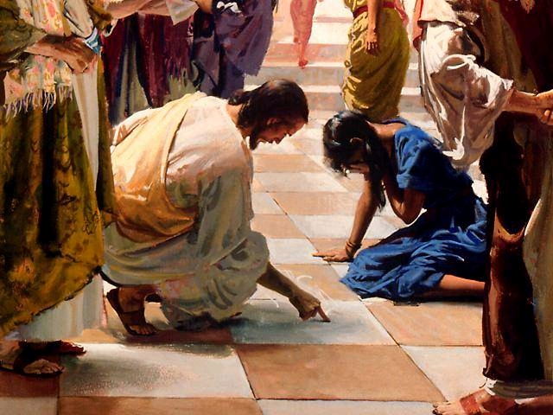
Isaiah 11:1-10
“A shoot will come up from the stump of Jesse; from his roots a Branch will bear fruit. ² The Spirit of the LORD will rest on him— the Spirit of wisdom and of understanding, the Spirit of counsel and of power, the Spirit of knowledge and of the fear of the LORD— ³ and he will delight in the fear of the LORD. He will not judge by what he sees with his eyes or decide by what he hears with his ears; ⁴ but with righteousness he will judge the needy, with justice he will give decisions for the poor of the earth. He will strike the earth with the rod of his mouth; with the breath of his lips he will slay the wicked. ⁵ Righteousness will be his belt and faithfulness the sash around his waist. ⁶ The wolf will live with the lamb, the leopard will lie down with the goat, the calf and the lion and the yearling together; and a little child will lead them. ⁷ The cow will feed with the bear, their young will lie down together, and the lion will eat straw like the ox. ⁸ The infant will play near the hole of the cobra, and the young child put his hand into the viper’s nest. ⁹ They will neither harm nor destroy on all my holy mountain, for the earth will be full of the knowledge of the LORD as the waters cover the sea. ¹⁰ In that day the Root of Jesse will stand as a banner for the peoples; the nations will rally to him, and his place of rest will be glorious.
赛11:1-10
“1从耶西的本必发一条，从他根生的枝子必结果实。2耶和华的灵必住在他身上，就是使他有智慧和聪明的灵，谋略和能力的灵，知识和敬畏耶和华的灵。3他必以敬畏耶和华为乐。行审判不凭眼见，断是非也不凭耳闻。4却要以公义审判贫穷人，以正直判断世上的谦卑人。以口中的杖击打世界。以嘴里的气杀戮恶人。5公义必当他的腰带，信实必当他胁下的带子。6豺狼必与绵羊羔同居，豹子与山羊羔同卧。少壮狮子，与牛犊，并肥畜同群。小孩子要牵引他们。7牛必与熊同食。牛犊必与小熊同卧。狮子必吃草与牛一样。8吃奶的孩子必玩耍在虺蛇的洞口，断奶的婴儿必按手在毒蛇的穴上。9在我圣山的遍处，这一切都不伤人，不害物。因为认识耶和华的知识要充满遍地，好像水充满洋海一般。10到那日，耶西的根立作万民的大旗。外邦人必寻求他。他安息之所大有荣耀。”

Slide 36
Isaiah 11:1-10
“A shoot will come up from the stump of Jesse; from his roots a Branch will bear fruit. ² The Spirit of the LORD will rest on him— the Spirit of wisdom and of understanding, the Spirit of counsel and of power, the Spirit of knowledge and of the fear of the LORD— ³ and he will delight in the fear of the LORD. He will not judge by what he sees with his eyes or decide by what he hears with his ears; ⁴ but with righteousness he will judge the needy, with justice he will give decisions for the poor of the earth. He will strike the earth with the rod of his mouth; with the breath of his lips he will slay the wicked. ⁵ Righteousness will be his belt and faithfulness the sash around his waist. ⁶ The wolf will live with the lamb, the leopard will lie down with the goat, the calf and the lion and the yearling together; and a little child will lead them. ⁷ The cow will feed with the bear, their young will lie down together, and the lion will eat straw like the ox. ⁸ The infant will play near the hole of the cobra, and the young child put his hand into the viper’s nest. ⁹ They will neither harm nor destroy on all my holy mountain, for the earth will be full of the knowledge of the LORD as the waters cover the sea. ¹⁰ In that day the Root of Jesse will stand as a banner for the peoples; the nations will rally to him, and his place of rest will be glorious.
赛11:1-10
“1从耶西的本必发一条，从他根生的枝子必结果实。2耶和华的灵必住在他身上，就是使他有智慧和聪明的灵，谋略和能力的灵，知识和敬畏耶和华的灵。3他必以敬畏耶和华为乐。行审判不凭眼见，断是非也不凭耳闻。4却要以公义审判贫穷人，以正直判断世上的谦卑人。以口中的杖击打世界。以嘴里的气杀戮恶人。5公义必当他的腰带，信实必当他胁下的带子。6豺狼必与绵羊羔同居，豹子与山羊羔同卧。少壮狮子，与牛犊，并肥畜同群。小孩子要牵引他们。7牛必与熊同食。牛犊必与小熊同卧。狮子必吃草与牛一样。8吃奶的孩子必玩耍在虺蛇的洞口，断奶的婴儿必按手在毒蛇的穴上。9在我圣山的遍处，这一切都不伤人，不害物。因为认识耶和华的知识要充满遍地，好像水充满洋海一般。10到那日，耶西的根立作万民的大旗。外邦人必寻求他。他安息之所大有荣耀。”
“There is a judge for the one who rejects me and does not accept my words; that very word which I spoke will condemn him at the last day.” (John 12:48)
“弃绝我不领受我话的人，有审判他的。就是我所讲的道，在末日要审判他。”（约12:48）

Slide 37
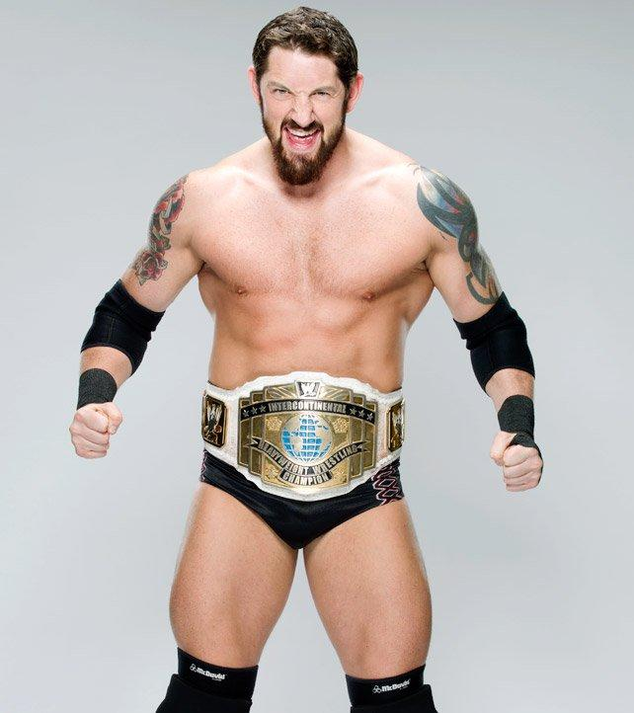
Isaiah 11:1-10
“A shoot will come up from the stump of Jesse; from his roots a Branch will bear fruit. ² The Spirit of the LORD will rest on him— the Spirit of wisdom and of understanding, the Spirit of counsel and of power, the Spirit of knowledge and of the fear of the LORD— ³ and he will delight in the fear of the LORD. He will not judge by what he sees with his eyes or decide by what he hears with his ears; ⁴ but with righteousness he will judge the needy, with justice he will give decisions for the poor of the earth. He will strike the earth with the rod of his mouth; with the breath of his lips he will slay the wicked. ⁵ Righteousness will be his belt and faithfulness the sash around his waist. ⁶ The wolf will live with the lamb, the leopard will lie down with the goat, the calf and the lion and the yearling together; and a little child will lead them. ⁷ The cow will feed with the bear, their young will lie down together, and the lion will eat straw like the ox. ⁸ The infant will play near the hole of the cobra, and the young child put his hand into the viper’s nest.
赛11:1-10
“1从耶西的本必发一条，从他根生的枝子必结果实。2耶和华的灵必住在他身上，就是使他有智慧和聪明的灵，谋略和能力的灵，知识和敬畏耶和华的灵。3他必以敬畏耶和华为乐。行审判不凭眼见，断是非也不凭耳闻。4却要以公义审判贫穷人，以正直判断世上的谦卑人。以口中的杖击打世界。以嘴里的气杀戮恶人。5公义必当他的腰带，信实必当他胁下的带子。6豺狼必与绵羊羔同居，豹子与山羊羔同卧。少壮狮子，与牛犊，并肥畜同群。小孩子要牵引他们。7牛必与熊同食。牛犊必与小熊同卧。狮子必吃草与牛一样。8吃奶的孩子必玩耍在虺蛇的洞口，断奶的婴儿必按手在毒蛇的穴上。9在我圣山的遍处，这一切都不伤人，不害物。因为认识耶和华的知识要充满遍地，好像水充满洋海一般。10到那日，耶西的根立作万民的大旗。外邦人必寻求他。他安息之所大有荣耀。”

Slide 38
Isaiah 11:1-10
“A shoot will come up from the stump of Jesse; from his roots a Branch will bear fruit. ² The Spirit of the LORD will rest on him— the Spirit of wisdom and of understanding, the Spirit of counsel and of power, the Spirit of knowledge and of the fear of the LORD— ³ and he will delight in the fear of the LORD. He will not judge by what he sees with his eyes or decide by what he hears with his ears; ⁴ but with righteousness he will judge the needy, with justice he will give decisions for the poor of the earth. He will strike the earth with the rod of his mouth; with the breath of his lips he will slay the wicked. ⁵ Righteousness will be his belt and faithfulness the sash around his waist. ⁶ The wolf will live with the lamb, the leopard will lie down with the goat, the calf and the lion and the yearling together; and a little child will lead them. ⁷ The cow will feed with the bear, their young will lie down together, and the lion will eat straw like the ox. ⁸ The infant will play near the hole of the cobra, and the young child put his hand into the viper’s nest. ⁹ They will neither harm nor destroy on all my holy mountain, for the earth will be full of the knowledge of the LORD as the waters cover the sea. ¹⁰ In that day the Root of Jesse will stand as a banner for the peoples; the nations will rally to him, and his place of rest will be glorious.
赛11:1-10
“1从耶西的本必发一条，从他根生的枝子必结果实。2耶和华的灵必住在他身上，就是使他有智慧和聪明的灵，谋略和能力的灵，知识和敬畏耶和华的灵。3他必以敬畏耶和华为乐。行审判不凭眼见，断是非也不凭耳闻。4却要以公义审判贫穷人，以正直判断世上的谦卑人。以口中的杖击打世界。以嘴里的气杀戮恶人。5公义必当他的腰带，信实必当他胁下的带子。6豺狼必与绵羊羔同居，豹子与山羊羔同卧。少壮狮子，与牛犊，并肥畜同群。小孩子要牵引他们。7牛必与熊同食。牛犊必与小熊同卧。狮子必吃草与牛一样。8吃奶的孩子必玩耍在虺蛇的洞口，断奶的婴儿必按手在毒蛇的穴上。9在我圣山的遍处，这一切都不伤人，不害物。因为认识耶和华的知识要充满遍地，好像水充满洋海一般。10到那日，耶西的根立作万民的大旗。外邦人必寻求他。他安息之所大有荣耀。”

Slide 39
Isaiah 11:1-10
“A shoot will come up from the stump of Jesse; from his roots a Branch will bear fruit. ² The Spirit of the LORD will rest on him— the Spirit of wisdom and of understanding, the Spirit of counsel and of power, the Spirit of knowledge and of the fear of the LORD— ³ and he will delight in the fear of the LORD. He will not judge by what he sees with his eyes or decide by what he hears with his ears; ⁴ but with righteousness he will judge the needy, with justice he will give decisions for the poor of the earth. He will strike the earth with the rod of his mouth; with the breath of his lips he will slay the wicked. ⁵ Righteousness will be his belt and faithfulness the sash around his waist. ⁶ The wolf will live with the lamb, the leopard will lie down with the goat, the calf and the lion and the yearling together; and a little child will lead them. ⁷ The cow will feed with the bear, their young will lie down together, and the lion will eat straw like the ox. ⁸ The infant will play near the hole of the cobra, and the young child put his hand into the viper’s nest. ⁹ They will neither harm nor destroy on all my holy mountain, for the earth will be full of the knowledge of the LORD as the waters cover the sea. ¹⁰ In that day the Root of Jesse will stand as a banner for the peoples; the nations will rally to him, and his place of rest will be glorious.
赛11:1-10
“1从耶西的本必发一条，从他根生的枝子必结果实。2耶和华的灵必住在他身上，就是使他有智慧和聪明的灵，谋略和能力的灵，知识和敬畏耶和华的灵。3他必以敬畏耶和华为乐。行审判不凭眼见，断是非也不凭耳闻。4却要以公义审判贫穷人，以正直判断世上的谦卑人。以口中的杖击打世界。以嘴里的气杀戮恶人。5公义必当他的腰带，信实必当他胁下的带子。6豺狼必与绵羊羔同居，豹子与山羊羔同卧。少壮狮子，与牛犊，并肥畜同群。小孩子要牵引他们。7牛必与熊同食。牛犊必与小熊同卧。狮子必吃草与牛一样。8吃奶的孩子必玩耍在虺蛇的洞口，断奶的婴儿必按手在毒蛇的穴上。9在我圣山的遍处，这一切都不伤人，不害物。因为认识耶和华的知识要充满遍地，好像水充满洋海一般。10到那日，耶西的根立作万民的大旗。外邦人必寻求他。他安息之所大有荣耀。”
“In the last days the mountain of the LORD’s temple will be established as chief among the mountains; it will be raised above the hills, and all nations will stream to it. Many peoples will come and say, “Come, let us go up to the mountain of the LORD, to the house of the God of Jacob. He will teach us his ways, so that we may walk in his paths.” The law will go out from Zion, the word of the LORD from Jerusalem. He will judge between the nations and will settle disputes for many peoples. They will beat their swords into plowshares and their spears into pruning hooks. Nation will not take up sword against nation, nor will they train for war anymore.” (Isaiah 2:2–4)
“末后的日子，耶和华殿的山必坚立，超乎诸山，高举过于万岭。万民都要流归这山。
必有许多国的民前往，说，来吧，我们登耶和华的山。奔雅各神的殿。主必将他的道教训我们，我们也要行他的路。因为训诲必出于锡安，耶和华的言语，必出于耶路撒冷。
他必在列国中施行审判，为许多国民断定是非。他们要将刀打成犁头，把枪打成镰刀。这国不举刀攻击那国，他们也不再学习战事。”（赛2:2-4）

Slide 40
Isaiah 11:1-10
“A shoot will come up from the stump of Jesse; from his roots a Branch will bear fruit. ² The Spirit of the LORD will rest on him— the Spirit of wisdom and of understanding, the Spirit of counsel and of power, the Spirit of knowledge and of the fear of the LORD— ³ and he will delight in the fear of the LORD. He will not judge by what he sees with his eyes or decide by what he hears with his ears; ⁴ but with righteousness he will judge the needy, with justice he will give decisions for the poor of the earth. He will strike the earth with the rod of his mouth; with the breath of his lips he will slay the wicked. ⁵ Righteousness will be his belt and faithfulness the sash around his waist. ⁶ The wolf will live with the lamb, the leopard will lie down with the goat, the calf and the lion and the yearling together; and a little child will lead them. ⁷ The cow will feed with the bear, their young will lie down together, and the lion will eat straw like the ox. ⁸ The infant will play near the hole of the cobra, and the young child put his hand into the viper’s nest. ⁹ They will neither harm nor destroy on all my holy mountain, for the earth will be full of the knowledge of the LORD as the waters cover the sea. ¹⁰ In that day the Root of Jesse will stand as a banner for the peoples; the nations will rally to him, and his place of rest will be glorious.
赛11:1-10
“1从耶西的本必发一条，从他根生的枝子必结果实。2耶和华的灵必住在他身上，就是使他有智慧和聪明的灵，谋略和能力的灵，知识和敬畏耶和华的灵。3他必以敬畏耶和华为乐。行审判不凭眼见，断是非也不凭耳闻。4却要以公义审判贫穷人，以正直判断世上的谦卑人。以口中的杖击打世界。以嘴里的气杀戮恶人。5公义必当他的腰带，信实必当他胁下的带子。6豺狼必与绵羊羔同居，豹子与山羊羔同卧。少壮狮子，与牛犊，并肥畜同群。小孩子要牵引他们。7牛必与熊同食。牛犊必与小熊同卧。狮子必吃草与牛一样。8吃奶的孩子必玩耍在虺蛇的洞口，断奶的婴儿必按手在毒蛇的穴上。9在我圣山的遍处，这一切都不伤人，不害物。因为认识耶和华的知识要充满遍地，好像水充满洋海一般。10到那日，耶西的根立作万民的大旗。外邦人必寻求他。他安息之所大有荣耀。”
“Great is the LORD, and most worthy of praise, in the city of our God, his holy mountain.” (Psalm 48:1)
“This is what the LORD says: “I will return to Zion and dwell in Jerusalem. Then Jerusalem will be called the City of Truth, and the mountain of the LORD Almighty will be called the Holy Mountain.” (Zechariah 8:3)
“And he carried me away in the Spirit to a mountain great and high, and showed me the Holy City, Jerusalem, coming down out of heaven from God.” (Revelation 21:10)
“耶和华本为大，在我们神的城中，在他的圣山上，该受大赞美。”（诗48:1）
“耶和华如此说，我现在回到锡安，要住在耶路撒冷中。耶路撒冷必称为诚实的城，万军之耶和华的山必称为圣山。”（亚8:3）
“我被圣灵感动，天使就带我到一座高大的山，将那由神那里从天而降的圣城耶路撒冷指示我” (启21:10)

Slide 41
Isaiah 11:1-10
“A shoot will come up from the stump of Jesse; from his roots a Branch will bear fruit. ² The Spirit of the LORD will rest on him— the Spirit of wisdom and of understanding, the Spirit of counsel and of power, the Spirit of knowledge and of the fear of the LORD— ³ and he will delight in the fear of the LORD. He will not judge by what he sees with his eyes or decide by what he hears with his ears; ⁴ but with righteousness he will judge the needy, with justice he will give decisions for the poor of the earth. He will strike the earth with the rod of his mouth; with the breath of his lips he will slay the wicked. ⁵ Righteousness will be his belt and faithfulness the sash around his waist. ⁶ The wolf will live with the lamb, the leopard will lie down with the goat, the calf and the lion and the yearling together; and a little child will lead them. ⁷ The cow will feed with the bear, their young will lie down together, and the lion will eat straw like the ox. ⁸ The infant will play near the hole of the cobra, and the young child put his hand into the viper’s nest. ⁹ They will neither harm nor destroy on all my holy mountain, for the earth will be full of the knowledge of the LORD as the waters cover the sea. ¹⁰ In that day the Root of Jesse will stand as a banner for the peoples; the nations will rally to him, and his place of rest will be glorious.
赛11:1-10
“1从耶西的本必发一条，从他根生的枝子必结果实。2耶和华的灵必住在他身上，就是使他有智慧和聪明的灵，谋略和能力的灵，知识和敬畏耶和华的灵。3他必以敬畏耶和华为乐。行审判不凭眼见，断是非也不凭耳闻。4却要以公义审判贫穷人，以正直判断世上的谦卑人。以口中的杖击打世界。以嘴里的气杀戮恶人。5公义必当他的腰带，信实必当他胁下的带子。6豺狼必与绵羊羔同居，豹子与山羊羔同卧。少壮狮子，与牛犊，并肥畜同群。小孩子要牵引他们。7牛必与熊同食。牛犊必与小熊同卧。狮子必吃草与牛一样。8吃奶的孩子必玩耍在虺蛇的洞口，断奶的婴儿必按手在毒蛇的穴上。9在我圣山的遍处，这一切都不伤人，不害物。因为认识耶和华的知识要充满遍地，好像水充满洋海一般。10到那日，耶西的根立作万民的大旗。外邦人必寻求他。他安息之所大有荣耀。”

Slide 42
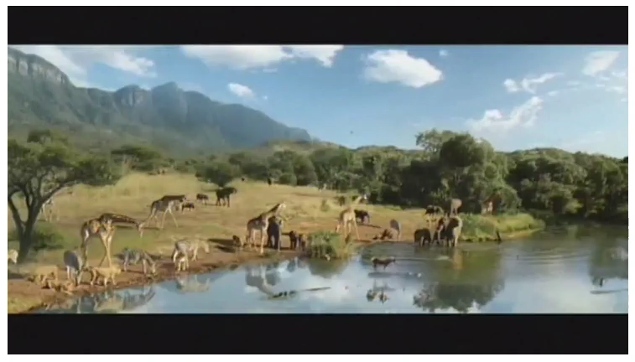

Slide 43
Isaiah 11:1-10
“A shoot will come up from the stump of Jesse; from his roots a Branch will bear fruit. ² The Spirit of the LORD will rest on him— the Spirit of wisdom and of understanding, the Spirit of counsel and of power, the Spirit of knowledge and of the fear of the LORD— ³ and he will delight in the fear of the LORD. He will not judge by what he sees with his eyes or decide by what he hears with his ears; ⁴ but with righteousness he will judge the needy, with justice he will give decisions for the poor of the earth. He will strike the earth with the rod of his mouth; with the breath of his lips he will slay the wicked. ⁵ Righteousness will be his belt and faithfulness the sash around his waist. ⁶ The wolf will live with the lamb, the leopard will lie down with the goat, the calf and the lion and the yearling together; and a little child will lead them. ⁷ The cow will feed with the bear, their young will lie down together, and the lion will eat straw like the ox. ⁸ The infant will play near the hole of the cobra, and the young child put his hand into the viper’s nest. ⁹ They will neither harm nor destroy on all my holy mountain, for the earth will be full of the knowledge of the LORD as the waters cover the sea. ¹⁰ In that day the Root of Jesse will stand as a banner for the peoples; the nations will rally to him, and his place of rest will be glorious.
赛11:1-10
“1从耶西的本必发一条，从他根生的枝子必结果实。2耶和华的灵必住在他身上，就是使他有智慧和聪明的灵，谋略和能力的灵，知识和敬畏耶和华的灵。3他必以敬畏耶和华为乐。行审判不凭眼见，断是非也不凭耳闻。4却要以公义审判贫穷人，以正直判断世上的谦卑人。以口中的杖击打世界。以嘴里的气杀戮恶人。5公义必当他的腰带，信实必当他胁下的带子。6豺狼必与绵羊羔同居，豹子与山羊羔同卧。少壮狮子，与牛犊，并肥畜同群。小孩子要牵引他们。7牛必与熊同食。牛犊必与小熊同卧。狮子必吃草与牛一样。8吃奶的孩子必玩耍在虺蛇的洞口，断奶的婴儿必按手在毒蛇的穴上。9在我圣山的遍处，这一切都不伤人，不害物。因为认识耶和华的知识要充满遍地，好像水充满洋海一般。10到那日，耶西的根立作万民的大旗。外邦人必寻求他。他安息之所大有荣耀。”
“The fruit of righteousness will be peace; the effect of righteousness will be quietness and confidence forever” (Isaiah 32:17)
“公义的果效，必是平安。公义的效验，必是平稳，直到永远。”（赛32:17）

Slide 44
Isaiah 11:1-10
“A shoot will come up from the stump of Jesse; from his roots a Branch will bear fruit. ² The Spirit of the LORD will rest on him— the Spirit of wisdom and of understanding, the Spirit of counsel and of power, the Spirit of knowledge and of the fear of the LORD— ³ and he will delight in the fear of the LORD. He will not judge by what he sees with his eyes or decide by what he hears with his ears; ⁴ but with righteousness he will judge the needy, with justice he will give decisions for the poor of the earth. He will strike the earth with the rod of his mouth; with the breath of his lips he will slay the wicked. ⁵ Righteousness will be his belt and faithfulness the sash around his waist. ⁶ The wolf will live with the lamb, the leopard will lie down with the goat, the calf and the lion and the yearling together; and a little child will lead them. ⁷ The cow will feed with the bear, their young will lie down together, and the lion will eat straw like the ox. ⁸ The infant will play near the hole of the cobra, and the young child put his hand into the viper’s nest. ⁹ They will neither harm nor destroy on all my holy mountain, for the earth will be full of the knowledge of the LORD as the waters cover the sea. ¹⁰ In that day the Root of Jesse will stand as a banner for the peoples; the nations will rally to him, and his place of rest will be glorious.
赛11:1-10
“1从耶西的本必发一条，从他根生的枝子必结果实。2耶和华的灵必住在他身上，就是使他有智慧和聪明的灵，谋略和能力的灵，知识和敬畏耶和华的灵。3他必以敬畏耶和华为乐。行审判不凭眼见，断是非也不凭耳闻。4却要以公义审判贫穷人，以正直判断世上的谦卑人。以口中的杖击打世界。以嘴里的气杀戮恶人。5公义必当他的腰带，信实必当他胁下的带子。6豺狼必与绵羊羔同居，豹子与山羊羔同卧。少壮狮子，与牛犊，并肥畜同群。小孩子要牵引他们。7牛必与熊同食。牛犊必与小熊同卧。狮子必吃草与牛一样。8吃奶的孩子必玩耍在虺蛇的洞口，断奶的婴儿必按手在毒蛇的穴上。9在我圣山的遍处，这一切都不伤人，不害物。因为认识耶和华的知识要充满遍地，好像水充满洋海一般。10到那日，耶西的根立作万民的大旗。外邦人必寻求他。他安息之所大有荣耀。”
John 12:31-33 – “Now is the time for judgment on this world; now the prince of this world will be driven out. But I, when I am lifted up from the earth, will draw all men to myself.” He said this to show the kind of death he was going to die.
约12:31-33-“现在这世界受审判。这世界的王要被赶出去。我若从地上被举起来，就要吸引万人来归我。耶稣这话原是指着自己将要怎样死说的。”

Slide 45
ISAIAH 11:1-10
赛11:1-10
23) What do we now know about the Messiah?
我们现在知道关于弥赛亚的什么信息？
We learn that the Messiah will come after the kingdom of Judah has been “cut down”.我们知道弥赛亚到来的时候，是在犹大国被“剪除”之后。
We learn that the Messiah will be the champion of righteousness.我们知道弥赛亚是公义的王。
We learn that the Messiah’s kingdom will be a place of safety and peace.我们知道弥赛亚国度是安全和平安的所在。

